Slide 1







Industry Trends Analysis
Josh Lavin
January 2023

Slide 2



OUTLINE
Executive Summary
Introduction
Methodology
Results
Visualization – Charts
Dashboard
Discussion
Findings & Implications
Conclusion
Appendix

Slide 3

EXECUTIVE SUMMARY
Demographic from Survey
Primarily Male
College Educated
From Developed Countries
Trends in Programming Languages
Trends in Databases Utilized

Slide 4

INTRODUCTION
Over 11,000 developers were surveyed on what languages/databases they use most and what they would want to move to in the future
Web-based languages will remain the most popular
Python is becoming more desired
There is a want to move away from relational databases into ones that can handle more complex datasets
Audience Tech Companies & Schools/Programs selecting course material

Slide 5

METHODOLOGY
Data Collection
GitHub Job Postings
Stack Overflow Developer Survey
Preprocessing
Data Visualization
Presentation

Slide 6
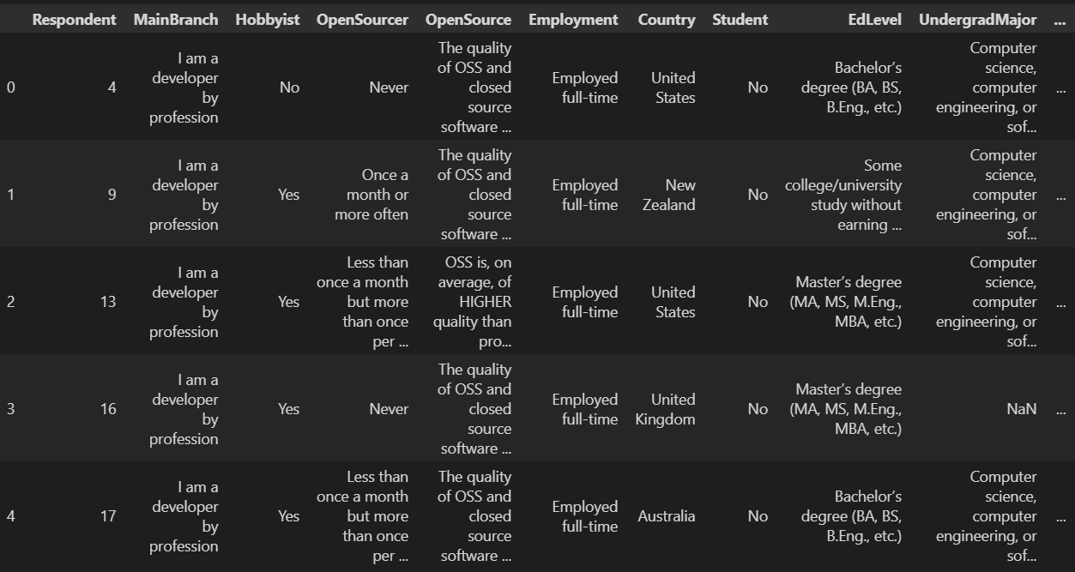
RESULTS
Example section of data table extracted from StackOverflow survey

Slide 7
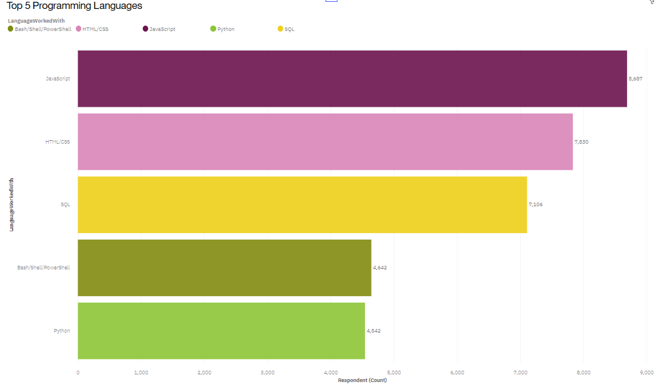
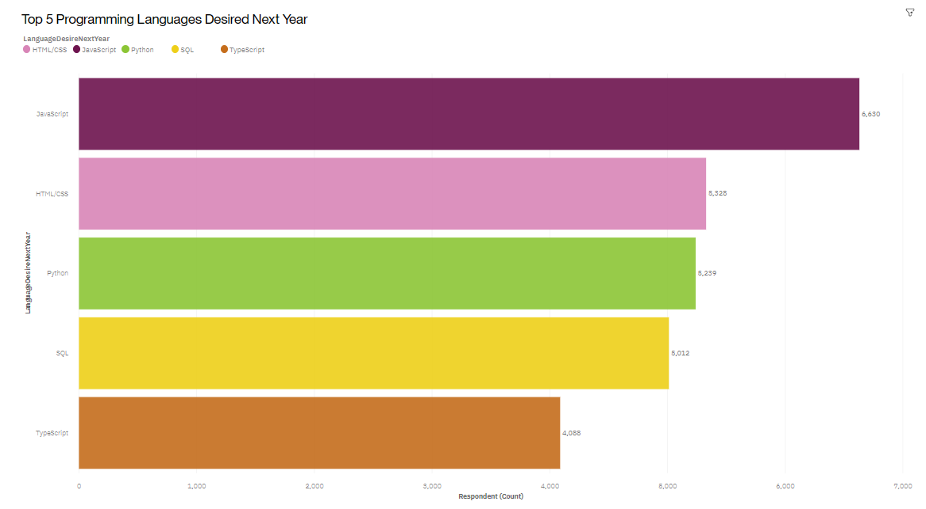
PROGRAMMING LANGUAGE TRENDS
Current Year
Next Year

Slide 8
PROGRAMMING LANGUAGE TRENDS - FINDINGS & IMPLICATIONS
Findings
JavaScript and HTML keep the top
Python makes large jump
Bash fell off
Implications
Web-based programming remains the most popular
There is increasing desire to move towards general purpose high-level programming
There is desire to move away from command-based languages

Slide 9
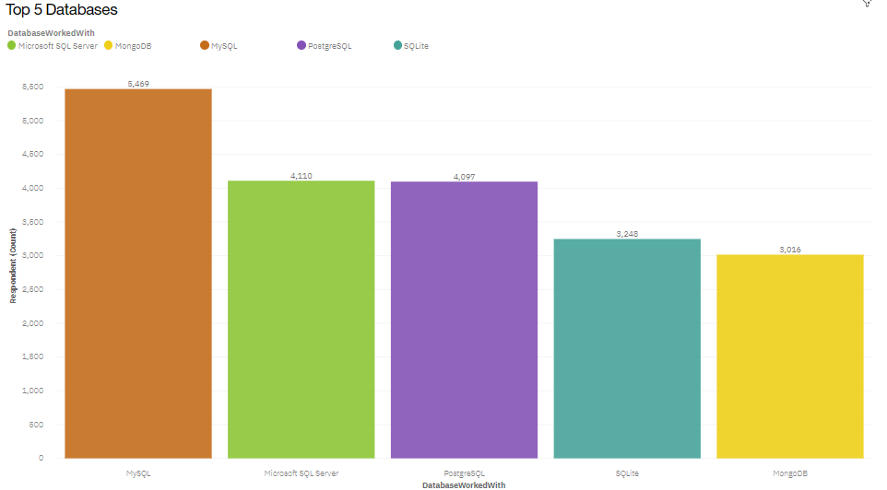
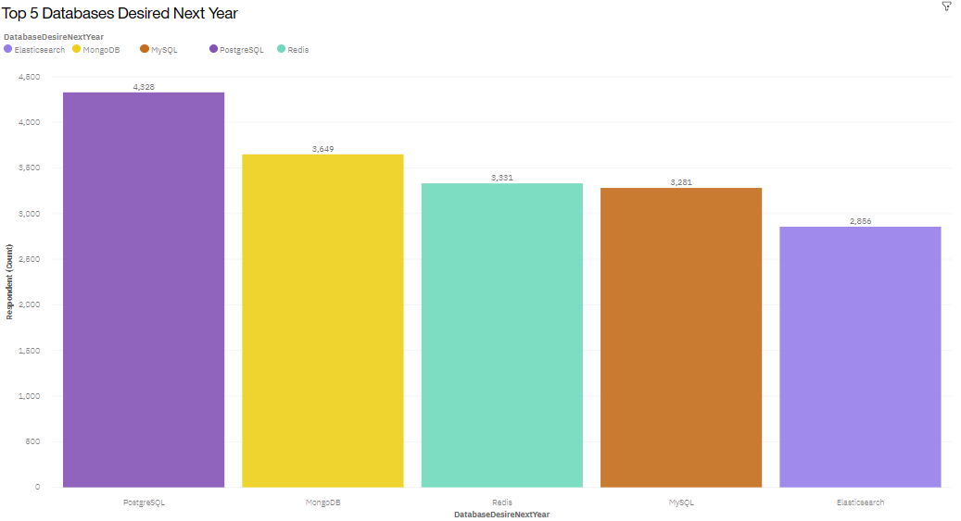
DATABASE TRENDS
Current Year
Next Year

Slide 10
DATABASE TRENDS - FINDINGS & IMPLICATIONS
Findings
PostgreSQL is the new immerging favorite
MySQL is becoming significantly less desired
Increase in non-SQL databases
Implications
There is desire for an object-relational database
MySQL is strictly relational which is limiting
There are several different database types emerging in response to more complex datasets

Slide 11

DASHBOARD
https://dataplatform.cloud.ibm.com/dashboards/69e4f1d1-0c59-4039-a994-3085a23286a6/view/463da422159c68f672f7b5e407cd2c527f65770be1bbd503d2d47b495b617497f3691591c82a1a5dd2130437f6e8435f9f

Slide 12
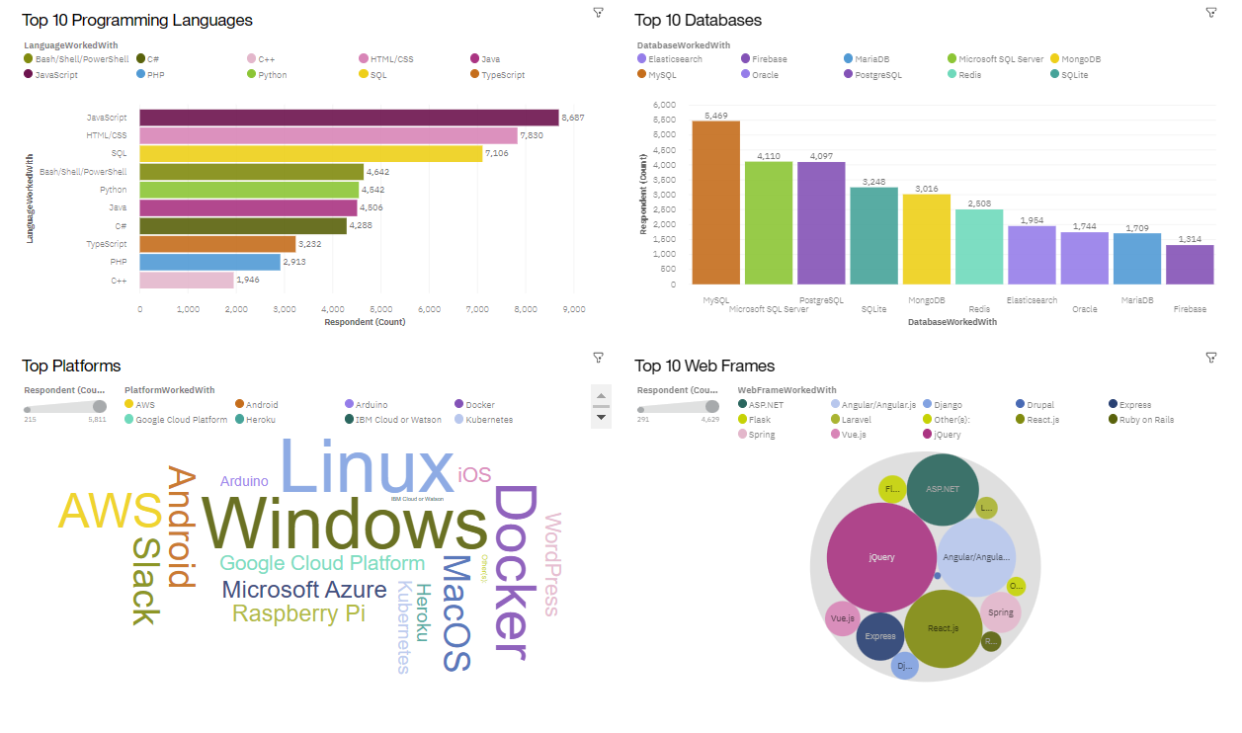
DASHBOARD TAB 1

Slide 13
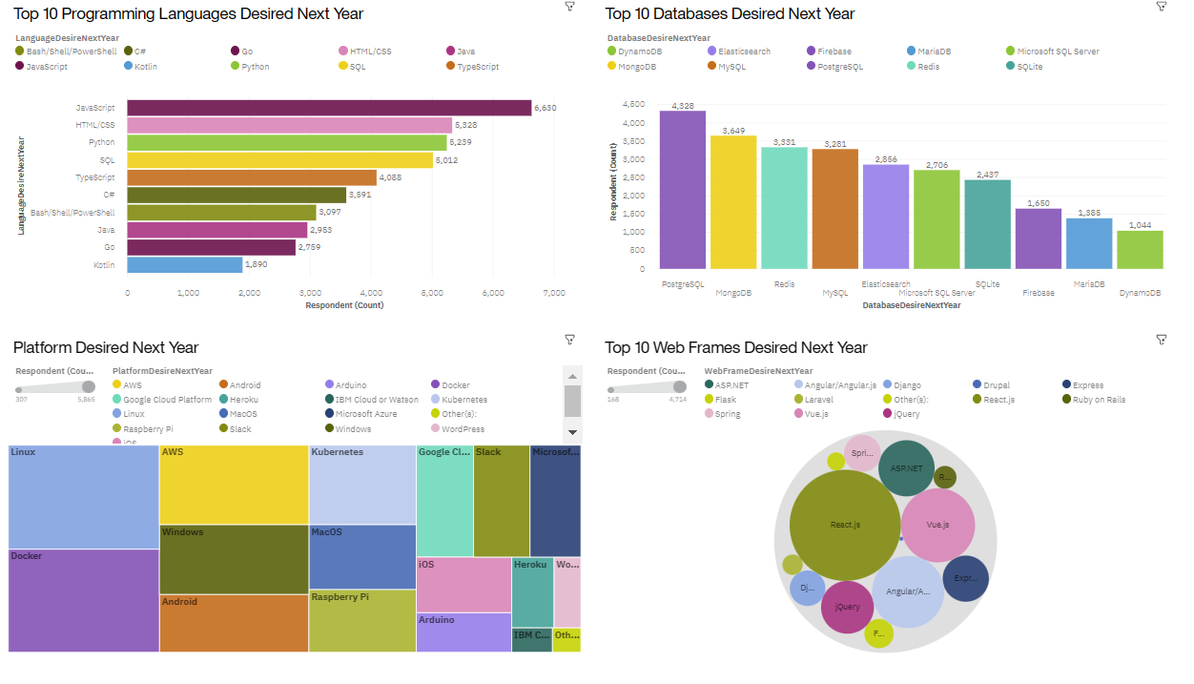
DASHBOARD TAB 2

Slide 14
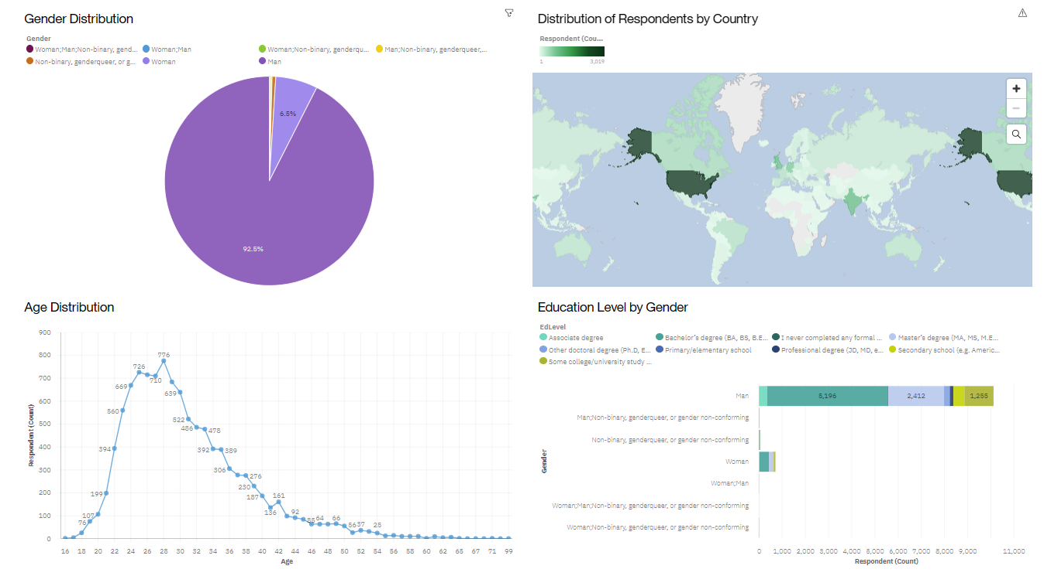
DASHBOARD TAB 3

Slide 15
DISCUSSION
Move towards Databases that can handle more complex datasets
Increase distribution amongst survey participants/field in general
Age
Education
Gender
Country

Slide 16
OVERALL FINDINGS & IMPLICATIONS
Findings
Languages stay consistent
Databases are changing
Demographics are concentrated
Implications
Web-based languages will continue to be utilized
Shift away from strictly relational databases. Increase in cloud-based services
Need to advocate for jobs in technology to all demographics

Slide 17

CONCLUSION
Continue to teach HTML/Javascript
Add Python support
Move from MySQL to more advanced databases
Reference machine learning to compare trends in salaries by language and jobs available by location

Slide 18
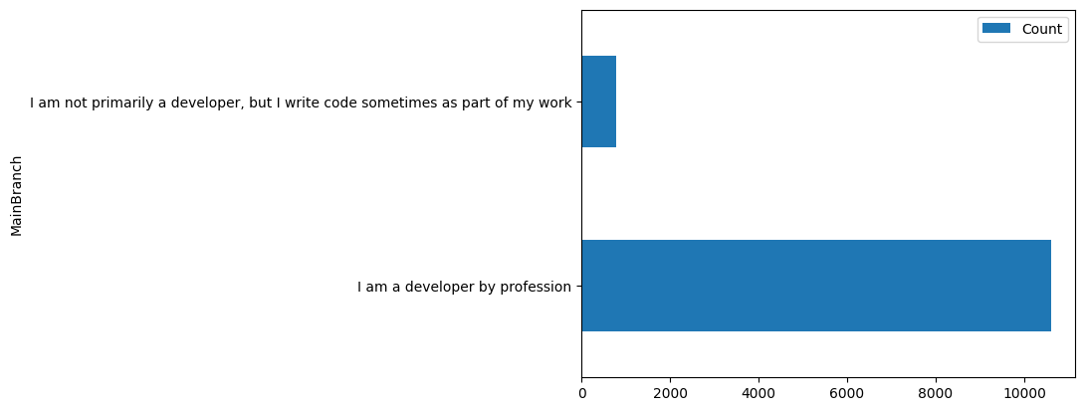

APPENDIX

Slide 19
JOB POSTINGS

Slide 20
POPULAR LANGUAGES

